Slide 1
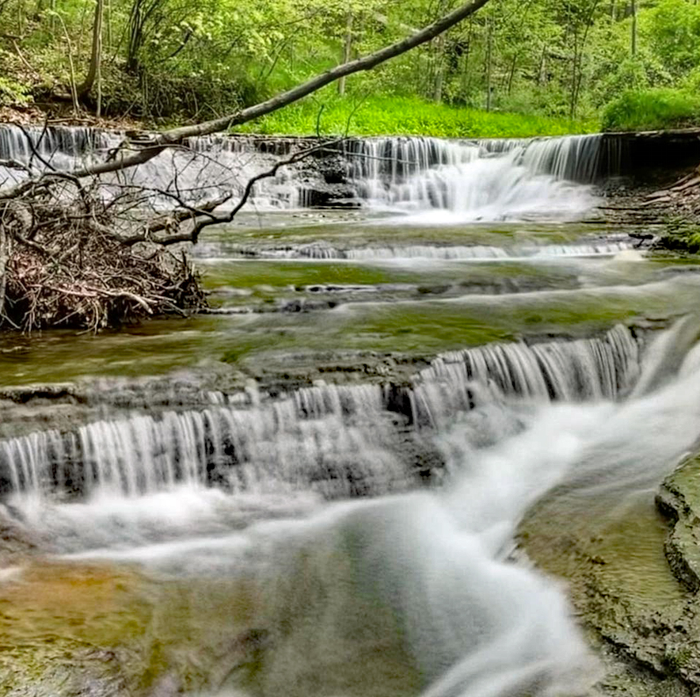
JORDAN CREEK PARK
7250 Alexander rD.
CONCORD TWP.

Slide 2
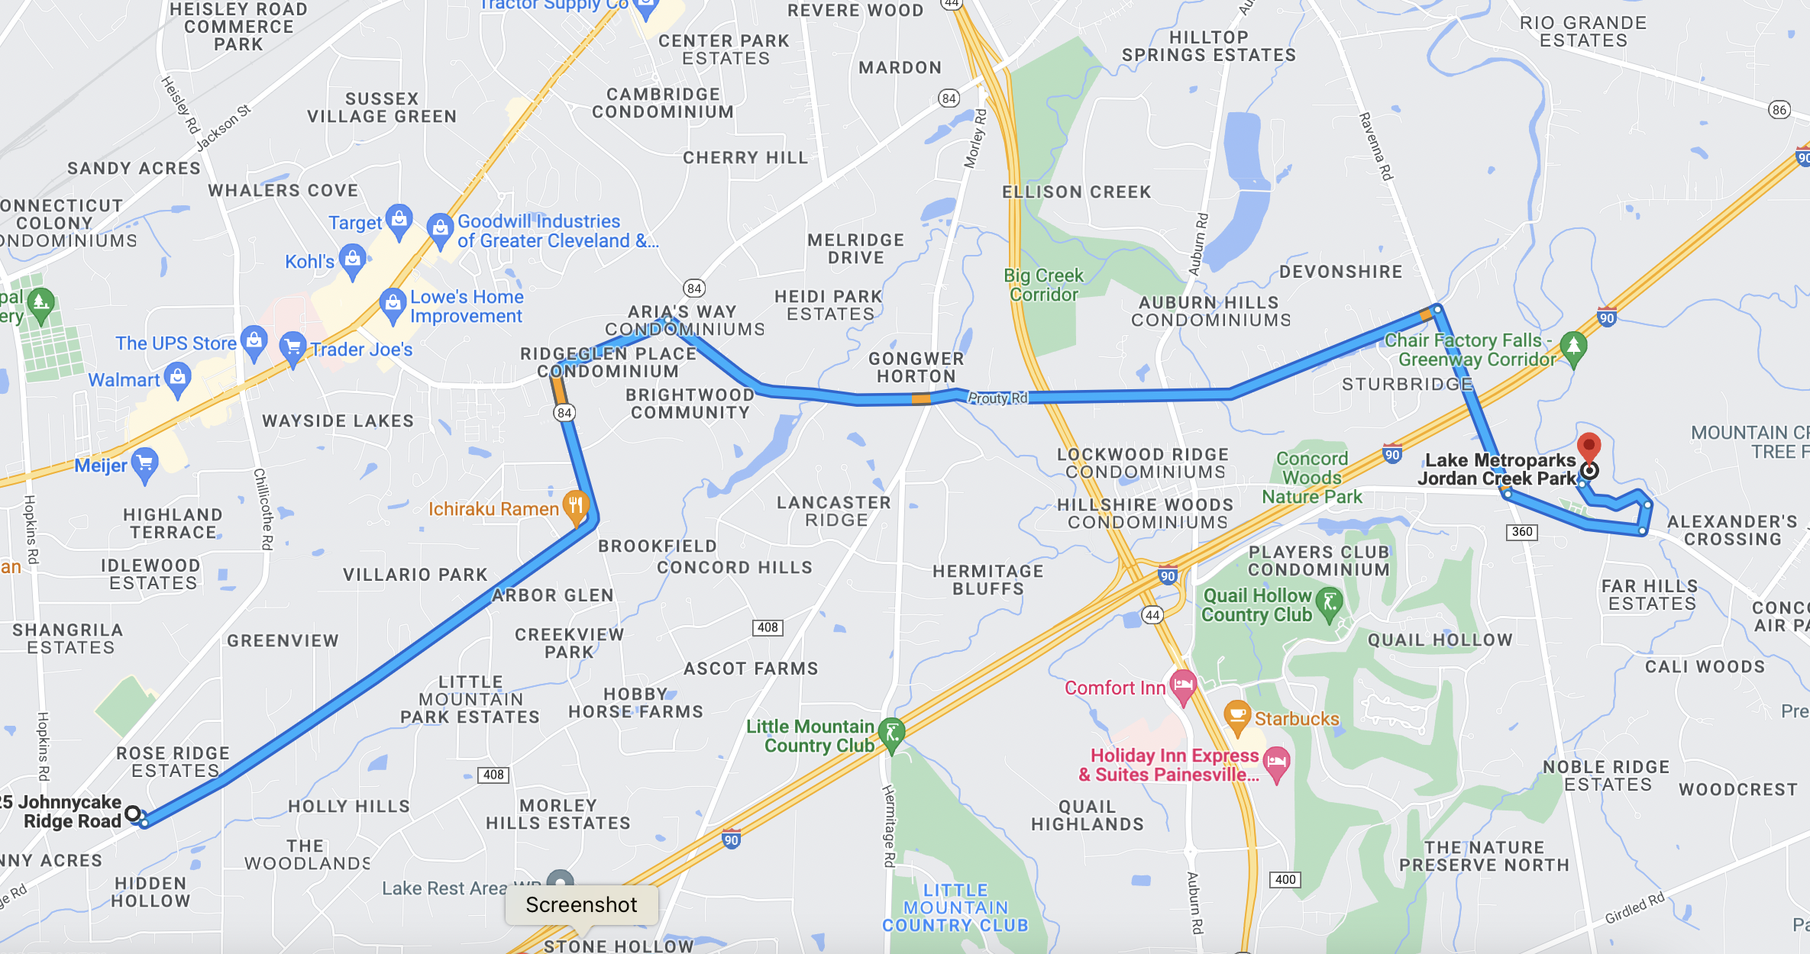
GOD, WHERE ARE YOU?
Lunch & Learn | MAY 2022

Slide 3

GOD, WHERE ARE YOU?
Lunch & Learn | MAY 2022

Slide 4
WE SEE GOD IN THE BEAUTY AND MYSTERY OF CREATION
For his invisible attributes, that is, his eternal power and divine nature, have been clearly seen since the creation of the world, being understood through what he has made. As a result, people are without excuse.
Romans 1:20
The heavens declare the glory of God, and the expanse proclaims the work of his hands.
Psalm 19:1

Slide 5
WE ENCOUNTER GOD THROUGH THE WORSHIP AND MUSIC OF HIS PEOPLE
But thou art holy,
O thou that inhabits the praises of Israel.
Psalm 22:3

Slide 6
WE FIND GOD IN THE COMMON, IN THE “STILL, SMALL VOICE”
Then he said, “Go out and stand on the mountain in the LORD’s presence.” At that moment, the LORD passed by. A great and mighty wind was tearing at the mountains and was shattering cliffs before the LORD, but the LORD was not in the wind. After the wind there was an earthquake, but the LORD was not in the earthquake. After the earthquake there was a fire, but the LORD was not in the fire. And after the fire there was a voice, a soft whisper.
1 Kings 19:11–12

Slide 7
WE KNOW GOD IN THE QUIET AND STILLNESS OF OUR HEARTS AND LIVES
He says, “Be still, and know that I am God; I will be exalted among the nations, I will be exalted in the earth.”
Psalm 46:10

Slide 8
WE COMMUNE WITH GOD IN THE BODY OF CHRIST, HIS CHURCH
Now you are the body of Christ, and individual members of it.
1 Corinthians 12:27
For where two or three are gathered together in my name, I am there among them.
Matthew 18:20

Slide 9
WE MEET GOD IN THE PERSON OF HIS SON
No one has ever seen God. The one and only Son, who is himself God and is at the Father’s side—he has revealed him.
John 1:18
That is, in Christ, God was reconciling the world to himself…
2 Corinthians 5:19a

Slide 10
WE EXPERIENCE GOD WITH THE BROKENHEARTED AND SUFFERING
The LORD is near the brokenhearted; he saves those crushed in spirit.
Psalm 34:18

